Slide 1
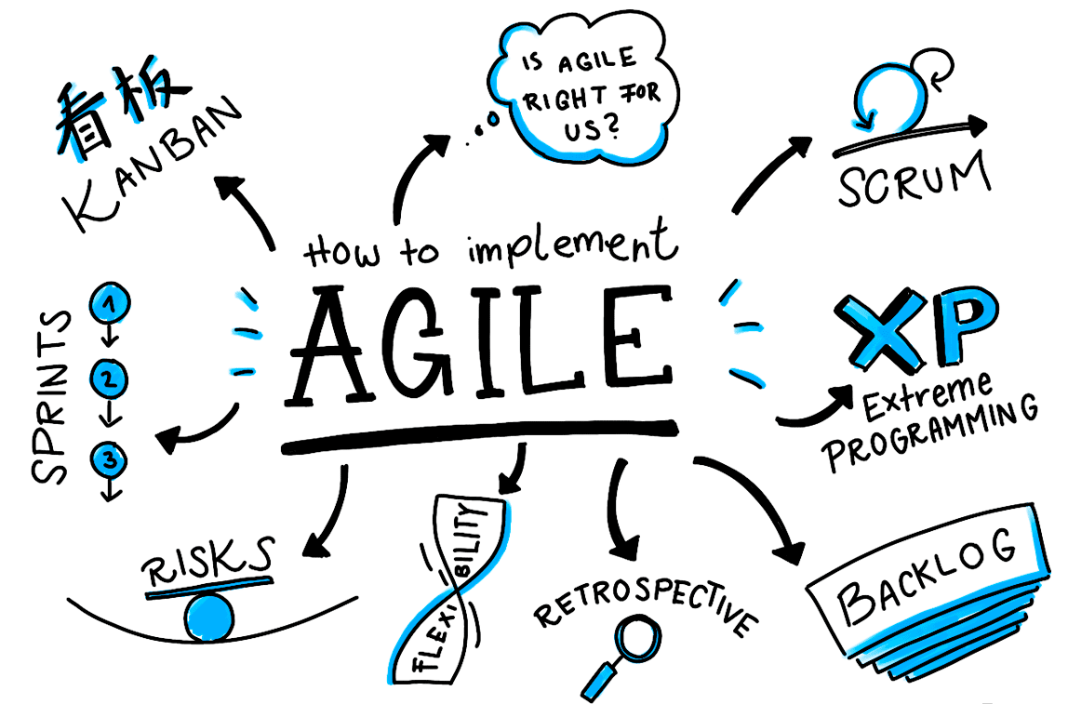
AGILE PROJECTS
Chapter 20
Team 5 – SWR302
Nguyen Tran Phong
Vo Van Thanh Phuc
Mai Thanh Hoang
Nguyen
The Nhan
Tran
Tan Long

Slide 2
CONTENTS
1
Limitations of the Waterfall
4
Adapting requirements practices to Agile projects
5
2
Transitioning to Agile: Now what?
The Agile Development approach
3
Essential aspects of an Agile approach to requirements

Slide 3
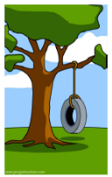
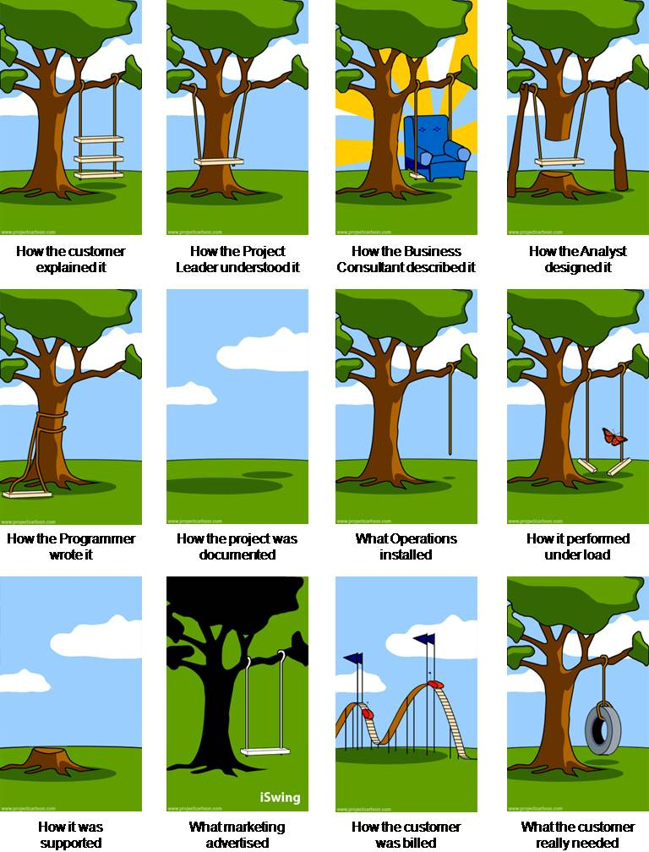
Limitations of the Waterfall
WHAT THE CUSTOMER
REALLY WANTED
HOW THE CUSTOMER
EXPLAINED IT
Requirements
HOW THE ANALYST
DESIGNED IT
Design
HOW THE PROGRAMMER
WROTE IT
Implementation
Testing
Deployment
Operation and Maintenance

Slide 4
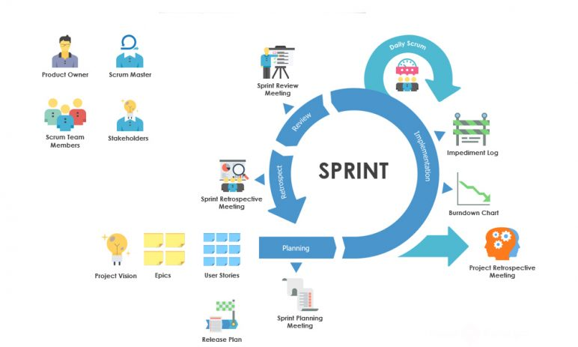
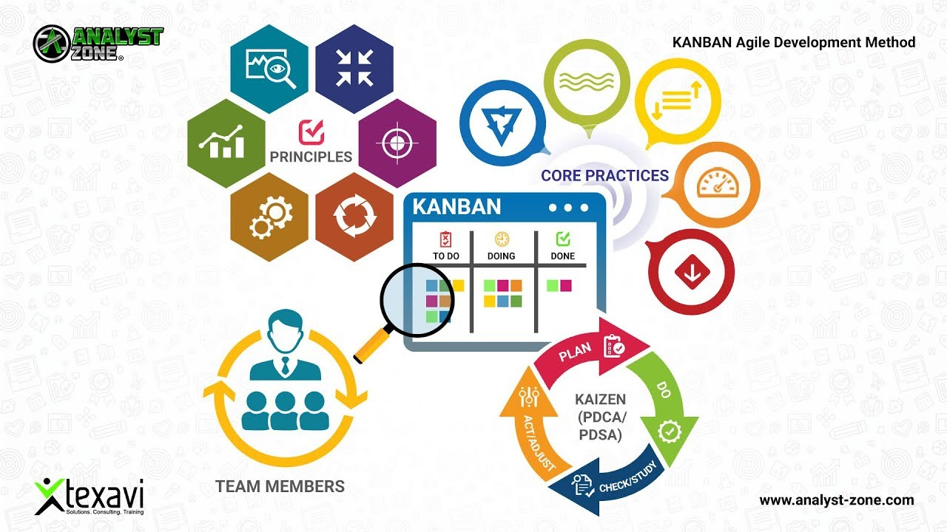
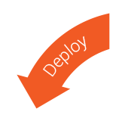
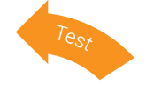
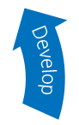
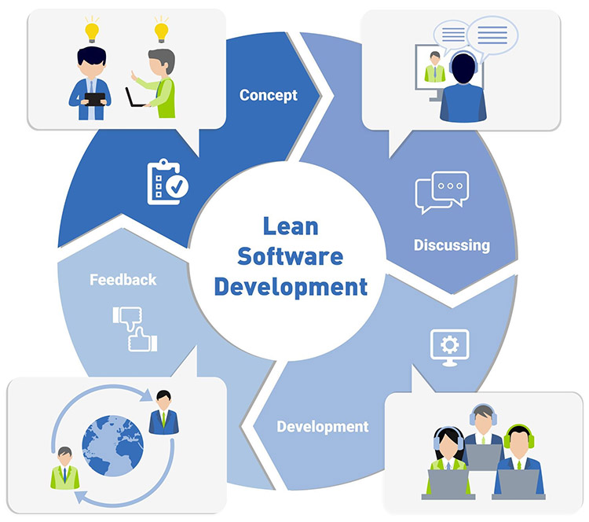
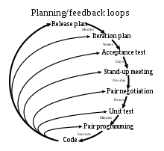
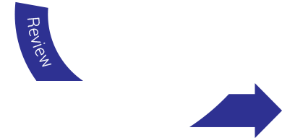
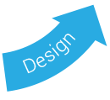
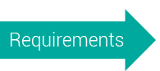
The Agile Development approach
SCRUM
KANBAN
AGILE
LEAN SOFTWARE
DEVELOPMENT
EXTREME
PROGRAMMING

Slide 5
The Agile Development approach
4 VALUES
12 PRINCIPLES
Individuals and interactions over processes and tools
Working software over comprehensive documentation
Customer collaboration over contract negotiation
Responding to change over following a plan
Our highest priority is to satisfy the customer through early and continuous delivery of valuable software.
Welcome changing requirements, even late in development. Agile processes harness change for the customer's competitive advantage.
Deliver working software frequently, from a couple of weeks to a couple of months, with a preference to the shorter timescale.
Business people and developers must work together daily throughout the project.
Build projects around motivated individuals. Give them the environment and support they need, and trust them to get the job done.
The most efficient and effective method of conveying information to and within a development team is face-to-face conversation.
Working software is the primary measure of progress.
Agile processes promote sustainable development. The sponsors, developers, and users should be able to maintain a constant pace indefinitely.
Continuous attention to technical excellence and good design enhances agility.
Simplicity--the art of maximizing the amount of work not done--is essential.
The best architectures, requirements, and designs emerge from self-organizing teams.
At regular intervals, the team reflects on how to become more effective, then tunes and adjusts its behavior accordingly.
https://agilemanifesto.org/

Slide 6

Essential aspects of an agile approach to requirements
CUSTOMER INVOLVEMENT
Waterfall
Agile
Requirements
Design
Implementation
AGILE
Testing
Deployment
Operation and Maintenance

Slide 7
Essential aspects of an agile approach to requirements
DOCUMENTATION DETAIL
Waterfall
Agile
The requirements must specify system behavior, data relationships, and user experience expectations in considerable detail.
Requirements can be documented in less detail.
BAs or other people responsible for requirements will develop the necessary precision through conversations and documentation when it is needed.

Slide 8
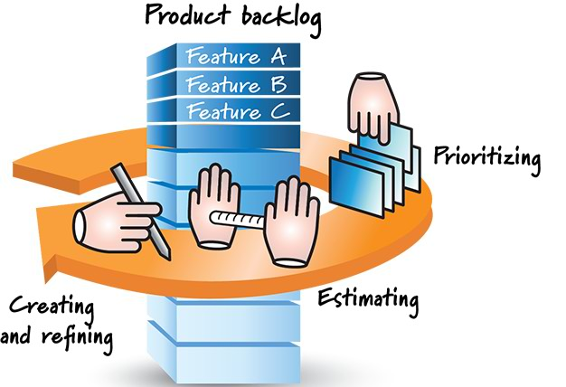


Essential aspects of an agile approach to requirements
THE BACKLOG AND PRIORITIZATION
Agile
The most important
Product Backlog
User Stories
Other Requirements
Business processes
Defects to be corrected

Slide 9
Essential aspects of an agile approach to requirements
TIMING
Waterfall
Elicit requirements from user representatives.
Analyze the requirements.
Document requirements of various kinds at appropriate levels of detail.
Validate that the requirements will achieve the business objectives for the project.
Requirements
Ecilitation
Analysis
Detailed Documents
Design
Validation
Specification
Implementation
Testing
Deployment
Operation and Maintenance

Slide 10
Essential aspects of an agile approach to requirements
TIMING
Agile
Product Backlog
User Story
User Story
User Story
User Story
User Story
User Story
AGILE
Documents increase in detail through iterations
AGILE
Ecilitation
Analysis
Ecilitation
Analysis
Specification
Validation
Specification
Validation
Iteration n
Iteration n + 1

Slide 11
Essential aspects of an agile approach to requirements
EPICS, USER STORIES, AND FEATURES
User Story
User Story
Representing Requirements, can be fully implemented in a single iteration
Epic
As a [role], I want to [task], so that I can [goal or benefit]
A user story that is too large to fully implemented in a single iteration
Feature
Feature
A single user story, multiple user stories, a single epic or multiple epics
Feature
As a web user, I want to list specific products by categories, so that I can find what I am looking for
Search feature:
As a web user, I want to list specific products by categories, so that I can find what I am looking for.
As a web user, I want to list specific products by manufacturer, so that I can choose products by the qualified manufacturer.

Slide 12

Essential aspects of an agile approach to requirements
EXPECT CHANGE
Wait, that’s out of scope
Okay, let’s talk about the change
We need to go through a formal process to incorporate that change
AGILE
Encourages customer collaboration to:
Create or change user stories
Prioritize each change request against everything else that’s already in the backlog

Slide 13
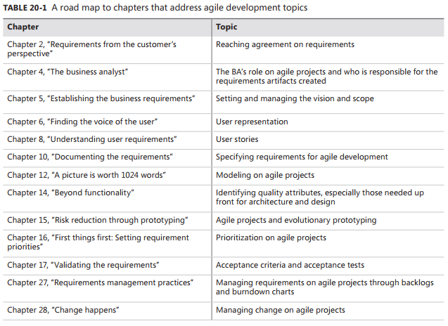
Adapting requirements practices to agile projects
13

Slide 14
Transitioning to agile: Now what?
Determine what your role is on the team – a BA.
Understand user stories, acceptance tests, backlog prioritization and why the agile BA is never “finished” until the end of the project or release.
Identify suggested agile practices (agile framework) that will work best in your organization.
Implement a small project first as a pilot for agile methods, or implement only a few agile practices on your next project.
If you are new to agile, bring in an experienced coach for three or four iterations to help you avoid the templation to revert to the historical practices with which you are comfortable.
Be agile when adopting agile practices.

Slide 15
REFERRENCES
Microsoft © Software Requirements, Third Edition, Karl Wiegers and Joy Beatty
https://agilemanifesto.org/
https://www.coursera.org/learn/agile-software-development/lecture/aNH2E/why-agile
https://viblo.asia/p/phan-biet-epics-user-stories-va-tasks-OeVKBwqQZkW

Slide 16
